Slide 1
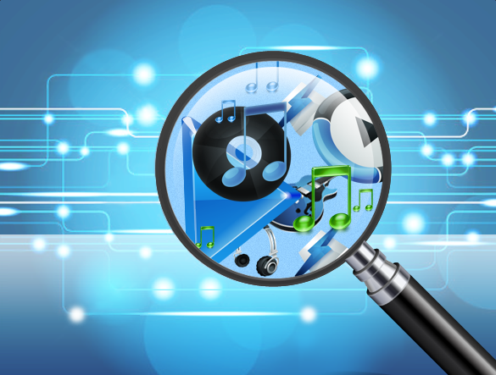
Audio Effects Generator
Amit Singha

Slide 2
What is Audio Effect?
Audio effects are hardware or software devices that alter the sound of an audio signal.
Various parameters, such as rate, feedback, and delay, can be used to control effects.
They are useful when performing live or in the studio when recording or mixing music.

Slide 3
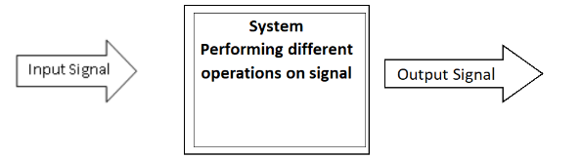
Basic Block Diagram

Slide 4
Types of Audio Effects
Audio effects can be broken down into five main categories:
Modulation effects—Chorus, Tremolo, Flanger and Phaser
Time-based effects—Reverb, Delay and Echo
Spectral effects—EQ and Panning
Dynamic effects—Compression and Distortion
Filters

Slide 5
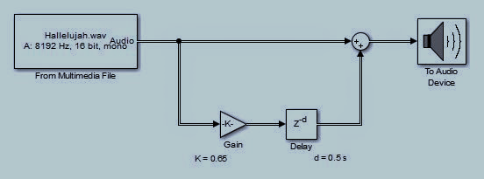
ECHO
Echo: Echo effects are a type of audio effect that occurs when a signal is delayed over time. Basically, it’s a reflection of sound that arrives at the listener with a delay after the direct sound.
Tunable Parameters : Delay, Gain

Slide 6
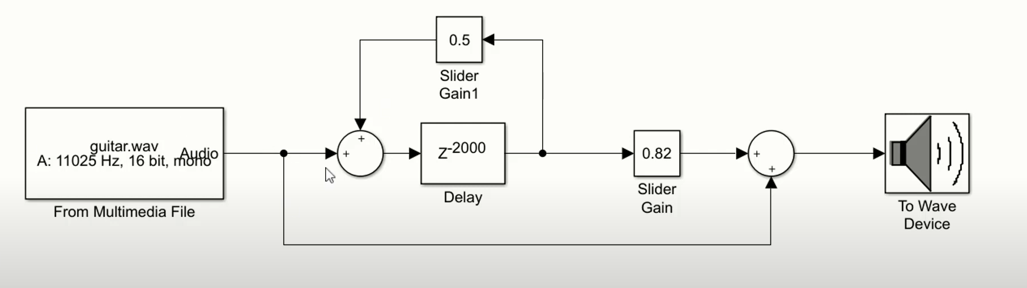
REVERB
Reverb: Reverb is created when a sound occurs in a space, sending sound waves out in all directions. Reverb provides space and depth to your mix, but it also gives the listener important clues about where the sound is taking place and where the listener is in relation to the sound

Slide 7
SLAPBACK
A short single-repeat echo effect often heard in '50s pop and rockabilly styles. Slapback delay is often used on electric guitar, but can also be applied to drums, vocals, and more. Delay times are usually short, in the range of 40-120 milliseconds.
The key component to a slapback is that the delay only repeats once. So if you play a note, that note will repeat once. This is different to a standard delay which will repeat multiple times and gradually fade away. A slapback is one very clear repeat.

Slide 8
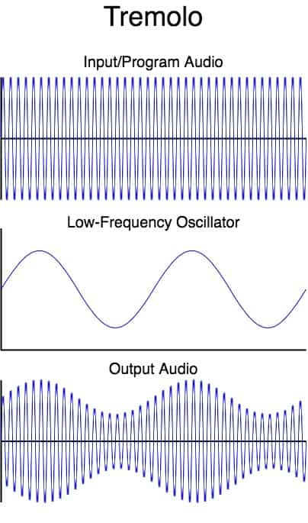
TREMOLO
Tremolo modulates the amplitude of the incoming signal, resulting in periodic volume changes.
Tremolo is a modulation effect that rhythmically changes the volume of your signal.

Slide 9
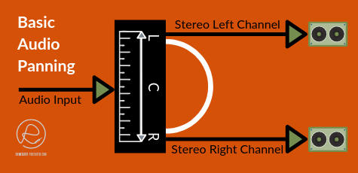
PANNING
Panning is the distribution of an audio signal (either monaural or stereophonic pairs) into a new stereo or multi-channel sound field determined by a pan control setting. For example, you can place more sound in the right channel of a stereo clip or less sound in the center channel of a surround clip.

Slide 10
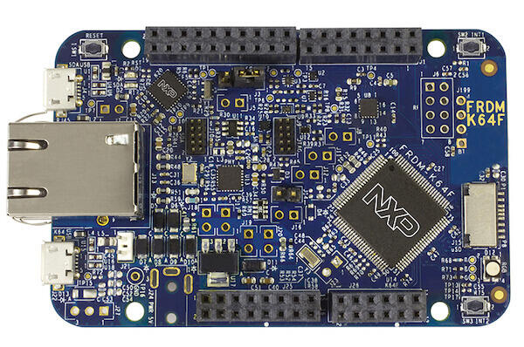
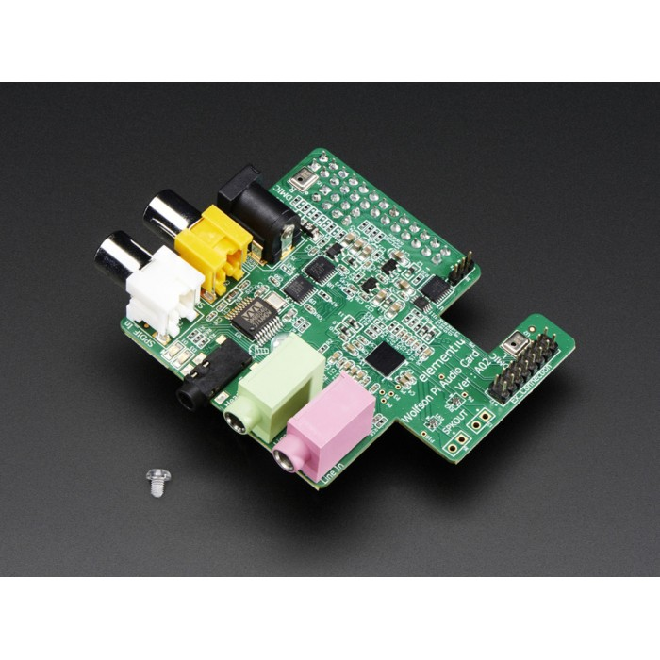
Hardware we used

Slide 11
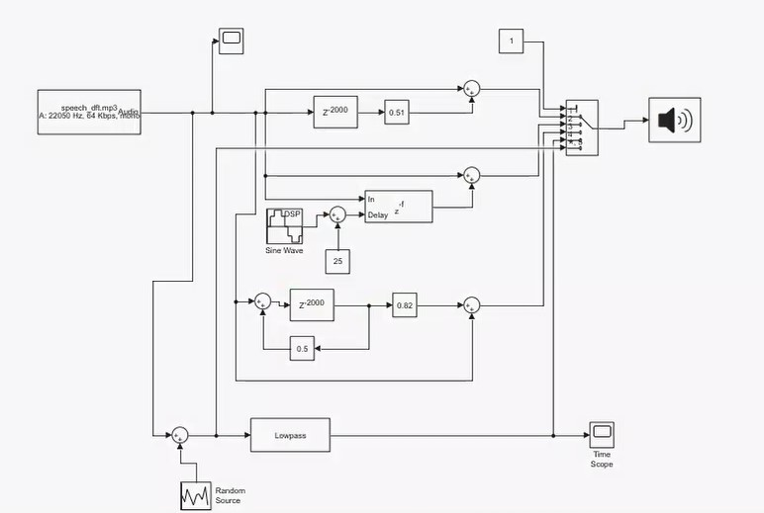
Our Model Architecture

Slide 12
MATLAB Model Video
www_screencapture_com_2022-12-5_12_17.mp4.mp4

Slide 13
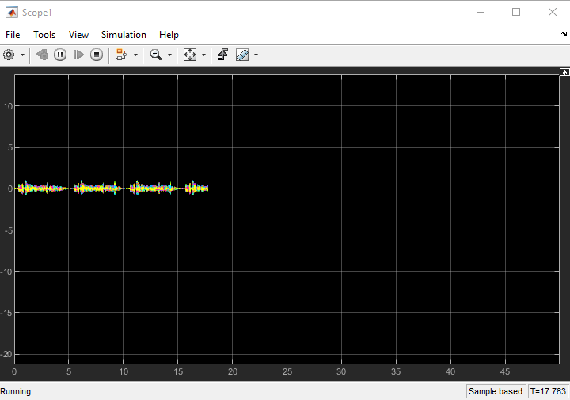
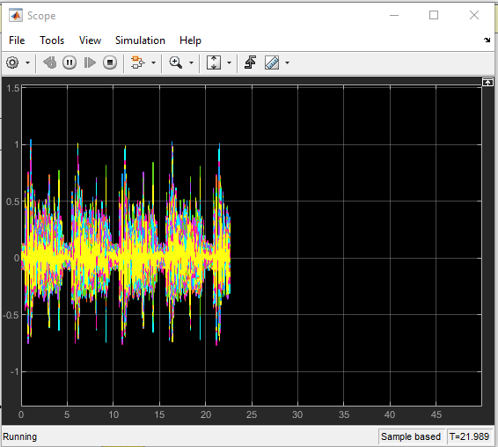
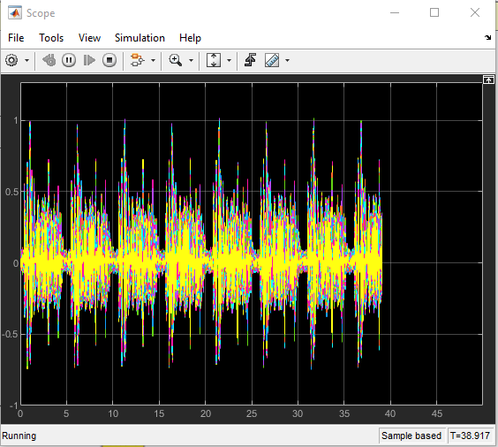
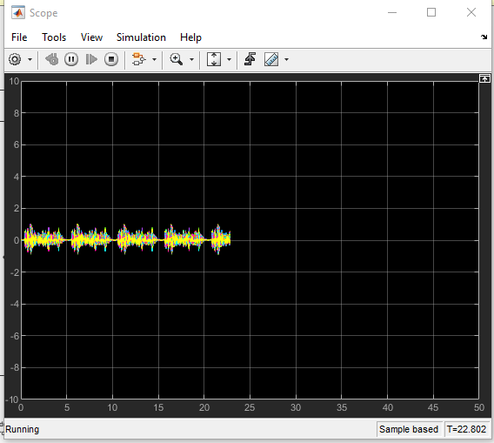
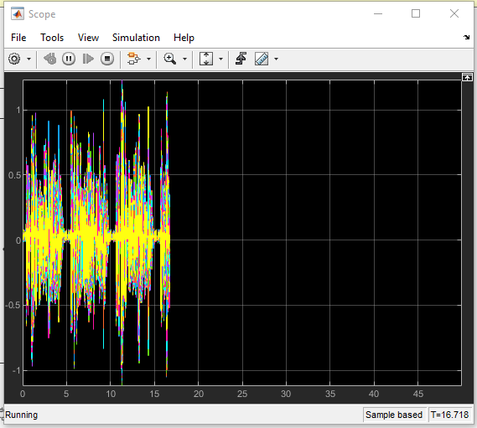
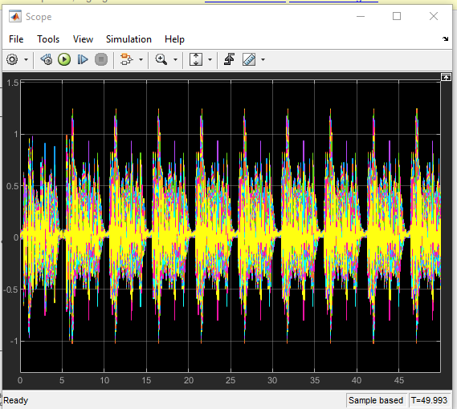
Waveform
Original Wave
Echo
Without Noise
With Noise
Reverb
Flanger

Slide 14
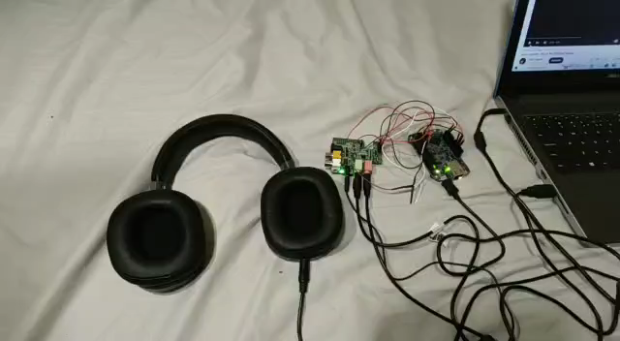
Echo

Slide 15
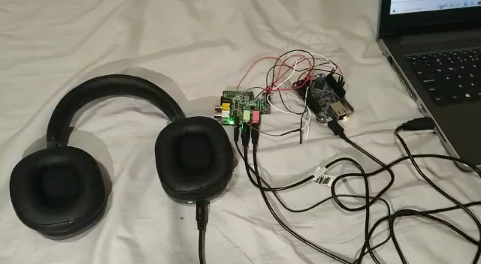
Tremolo

Slide 16
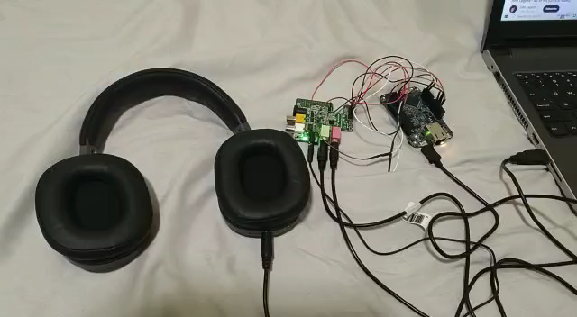
Chorus

Slide 17
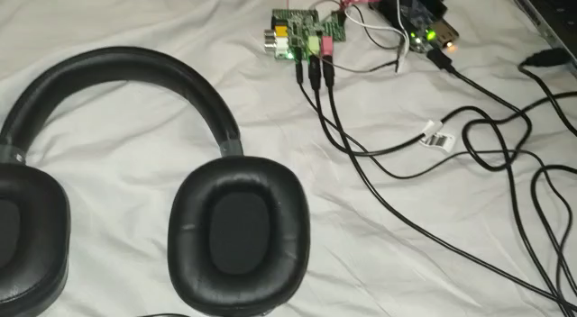
Slapback

Slide 18
Code Debug
Code Debug Capture.mp4

Slide 19
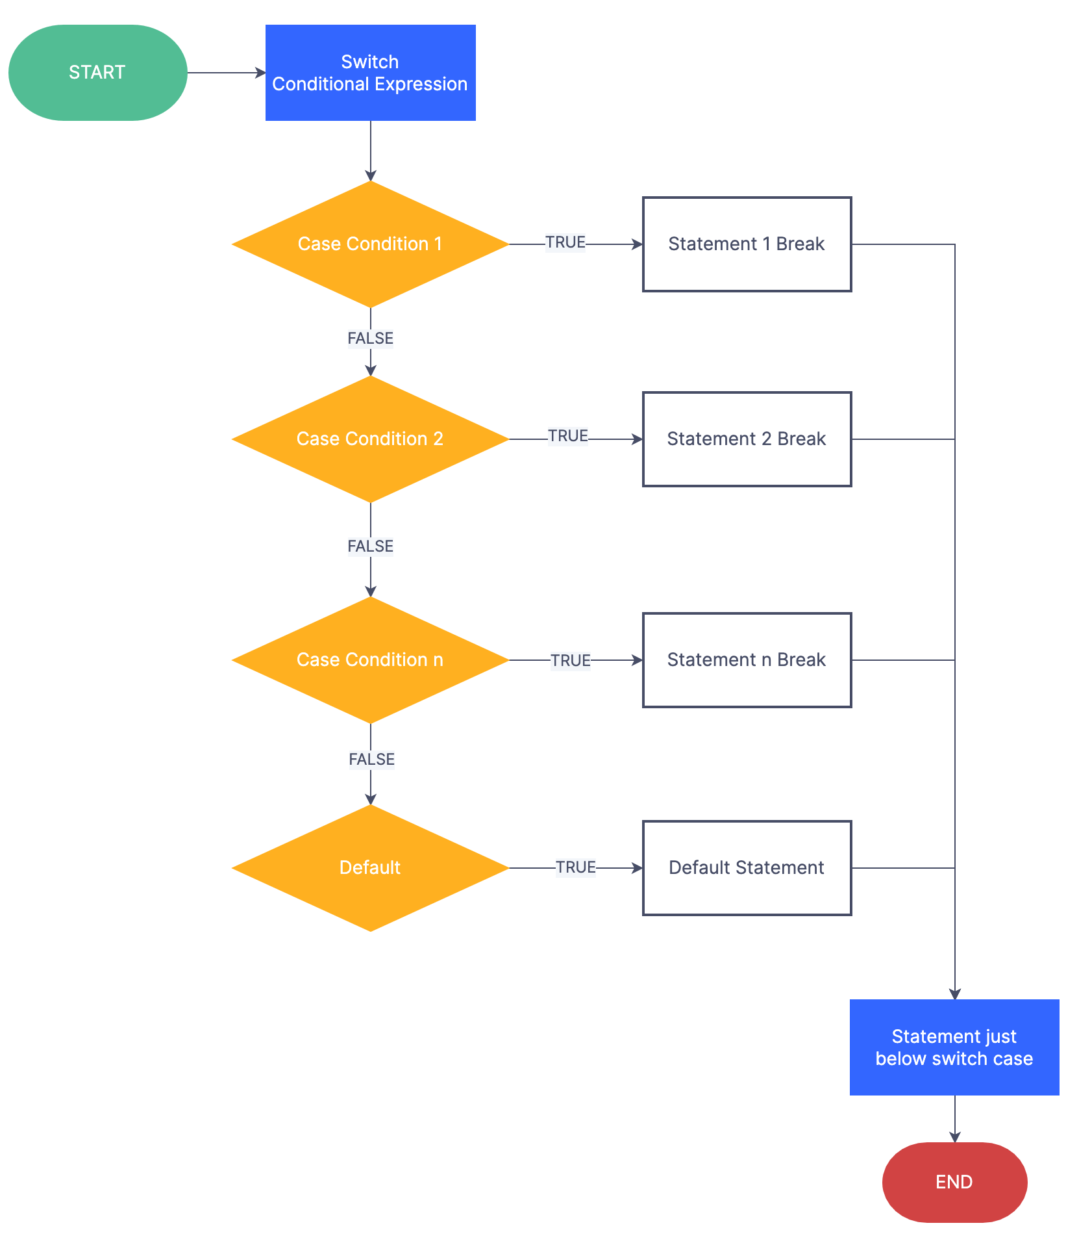
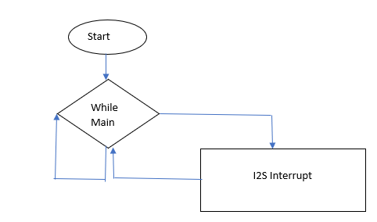
Implementation Methodology
Echo
Tremolo
Chorus
Slapback
Panning

Slide 20
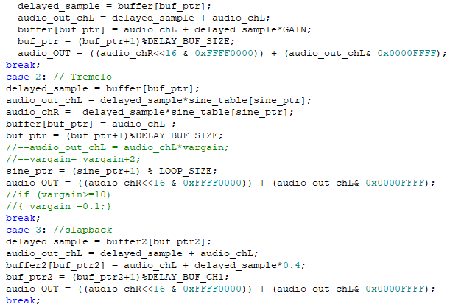
Code snippets

Slide 21
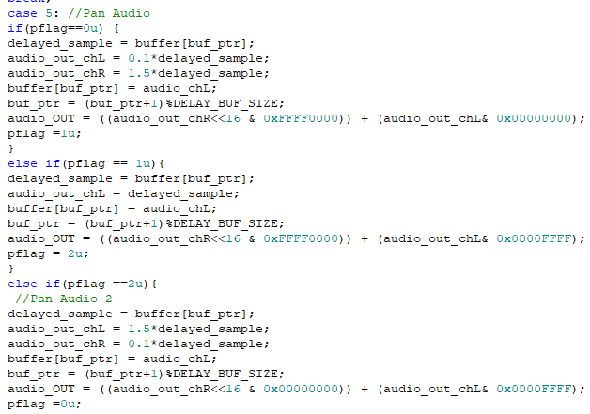
Code snippets , Debouncing Switch

Slide 22
Applications of Audio Effects
Recording or mixing music
Voice changer /Disguiser,
Bass booster and Equalizer
DJ Music Systems
Movies and Recording Studios.

Slide 23
References
ECE538 : DSP-LAB 1 , 5, 6.
Introduction to Signal Processing, Sophocles J. Orfanidis
Digital Signal Processing Principles, Algorithms and Applications Third Edition, John G. Proakis and Dimitris G. Manolakis

